Slide 1





SQL
STEP
BY STEP
BASIC ADVANCE
Make Sure To Download Or Clone This Repo
https://github.com/yaswanthteja/Complete_SQL/

Slide 2



Introduction to SQL-What Is SQL & Database
Data Types, Primary-Foreign Keys & Constraints
Install postgresql and pgadmin4
Create Table In SQL & Create Database
INSERT UPDATE, DELETE & ALTER Table
SELECT Statement & WHERE Clause with Example
How To Import Excel File (CSV) to SQL
Functions in SQL & String Function
Aggregate Functions – Types & Syntax
Group By and Having Clause
Time Stamp and Extract Function, Date Time Function
SQL JOINS – Types & Syntax
SELF JOIN, UNION & UNION ALL
Subquery
Window Function – Types & Syntax
Case Statement/Expression with examples
CTE- Common Table Expression with examples

Slide 4
WHAT IS SQL & DATABASE- INTRODUCTION
Make Sure To Download Or Clone This Repo
https://github.com/yaswanthteja/Complete_SQL/

Slide 5
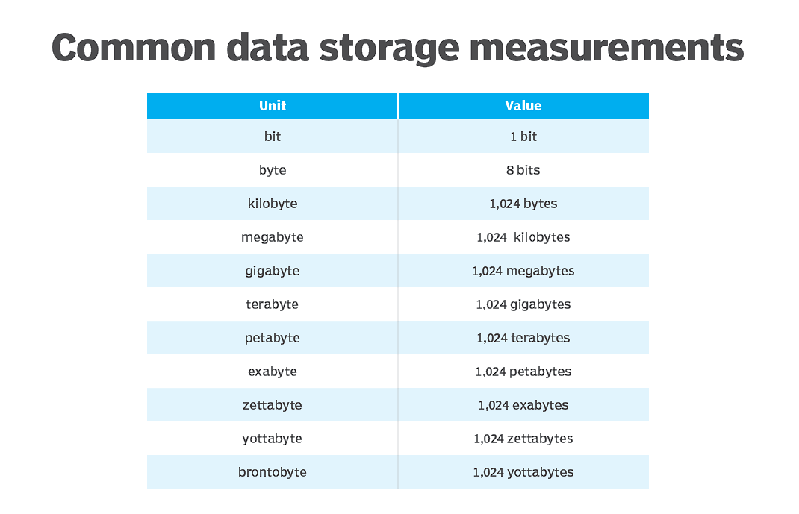
Basics of Data & Databases
What is Data?
Data is raw facts and figures that by themselves may not have meaning.
Think of data as individual Lego blocks — on their own they’re just pieces, but when arranged, they form meaningful structures.
Examples: Numbers, Text, Dates
2. Data Sizes & Storage Capacities
Computers store data in bits and bytes.
1 bit Smallest unit (0 or 1)

Slide 6




Database is a system that allow users to store and organise data

Slide 7

Excel | Database
Easy to use- untrained person can work | Trained person can work
Data stored less data | Stores large amount of data
Good for one time analysis, quick charts | Can automate tasks
No data integrity due to manual operation | High data integrity
Low search/filter capabilities | High search/filter capabilities

Slide 8
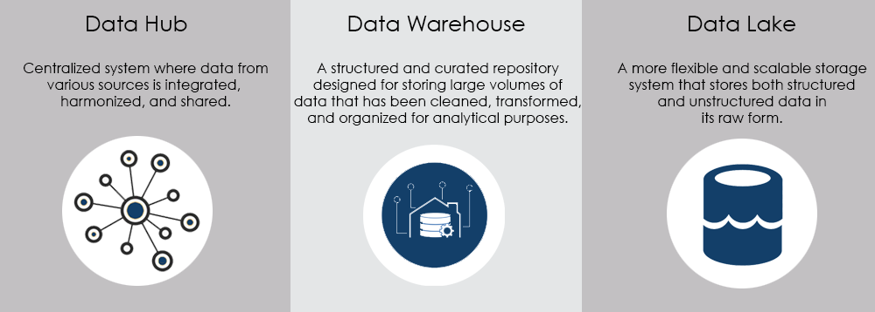
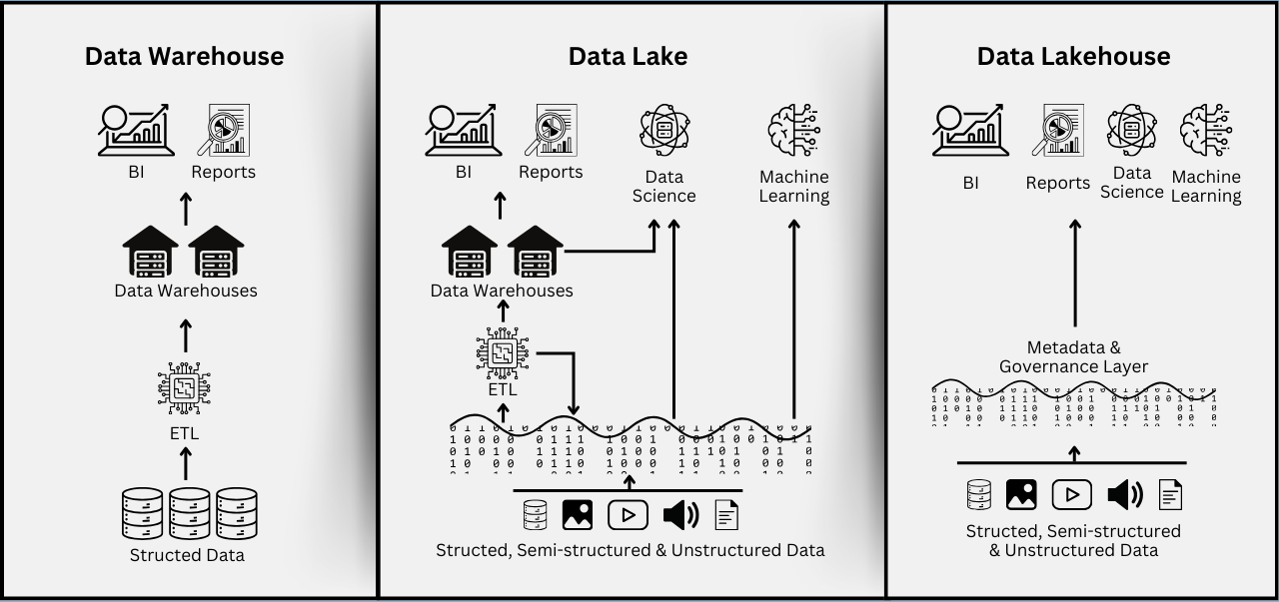
Data Warehouse
A data warehouse is a large, organized storage system that holds cleaned and structured data from different sources.
Data Lake
A data lake is a storage system that holds raw, unprocessed data — including files, videos, logs, and more.
Data Hub
A data hub is a central place where different systems share and exchange data in real time.

Slide 9





SQL (Structured Query Language) is a programming language used to interact with database

Slide 10



Slide 11



Slide 12

Relational Database | Non-Relational Database
SQL database | NoSQL database
Data stored in tables | Data stored are either key-value pairs, document-based, graph databases or wide- column stores
These databases have fixed or static or predefined schema | They have dynamic schema
Low performance with huge volumes of data | Easily work with huge volumes of data
Eg: PostgreSQL, MySQL, MS SQL Server | Eg: MongoDB, Cassandra, Hbase

Slide 13

There are mainly 5 types of SQL commands:
DDL (Data Definition Language): used to define and modify the structure of database
create, alter, drop, truncate, rename
DML (Data Manipulation Language): used to manage data inside tables
insert, update and delete
DCL (Data Control Language): used to control access to data in the database.
grant , revoke permission to users

Slide 14
DQL (Data Query Language ) : Used to retrieve data from the database.
select
TCL (Transaction Control Language): Used to manage transactions and ensure data integrity.
commit, savepoint, rollback, set transaction

Slide 15
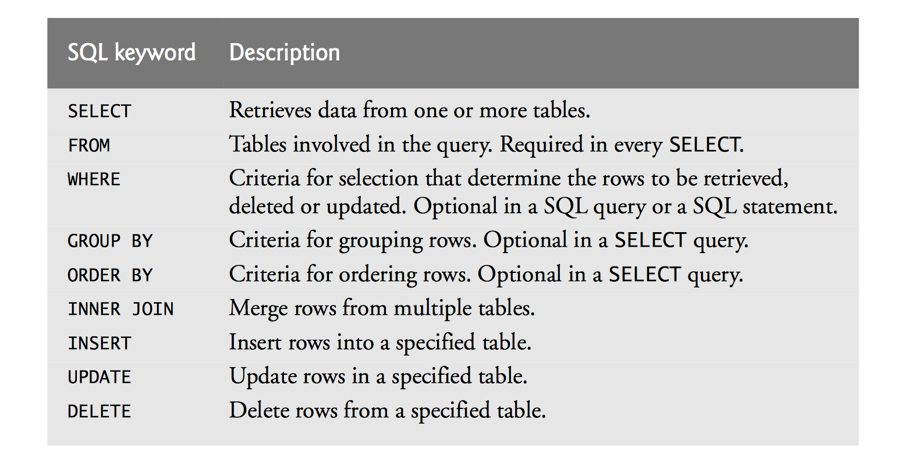
SQL keywords are reserved words that define the structure and behavior of SQL commands.
They cannot be used as table or column names and are essential for writing queries.

Slide 16
DATA TYPES, PRIMARY & FOREIGN KEYS, CONSTRAINTS

Slide 17

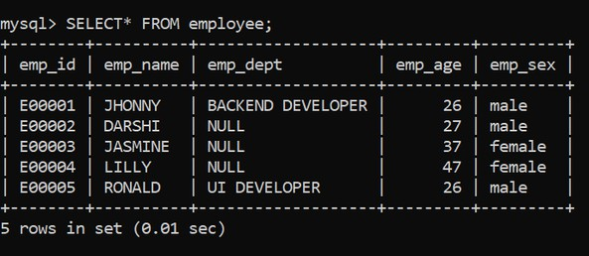
Example
Database
Columns
Tables
Data
(Rows & Columns)
Rows
RDBMS

Slide 18
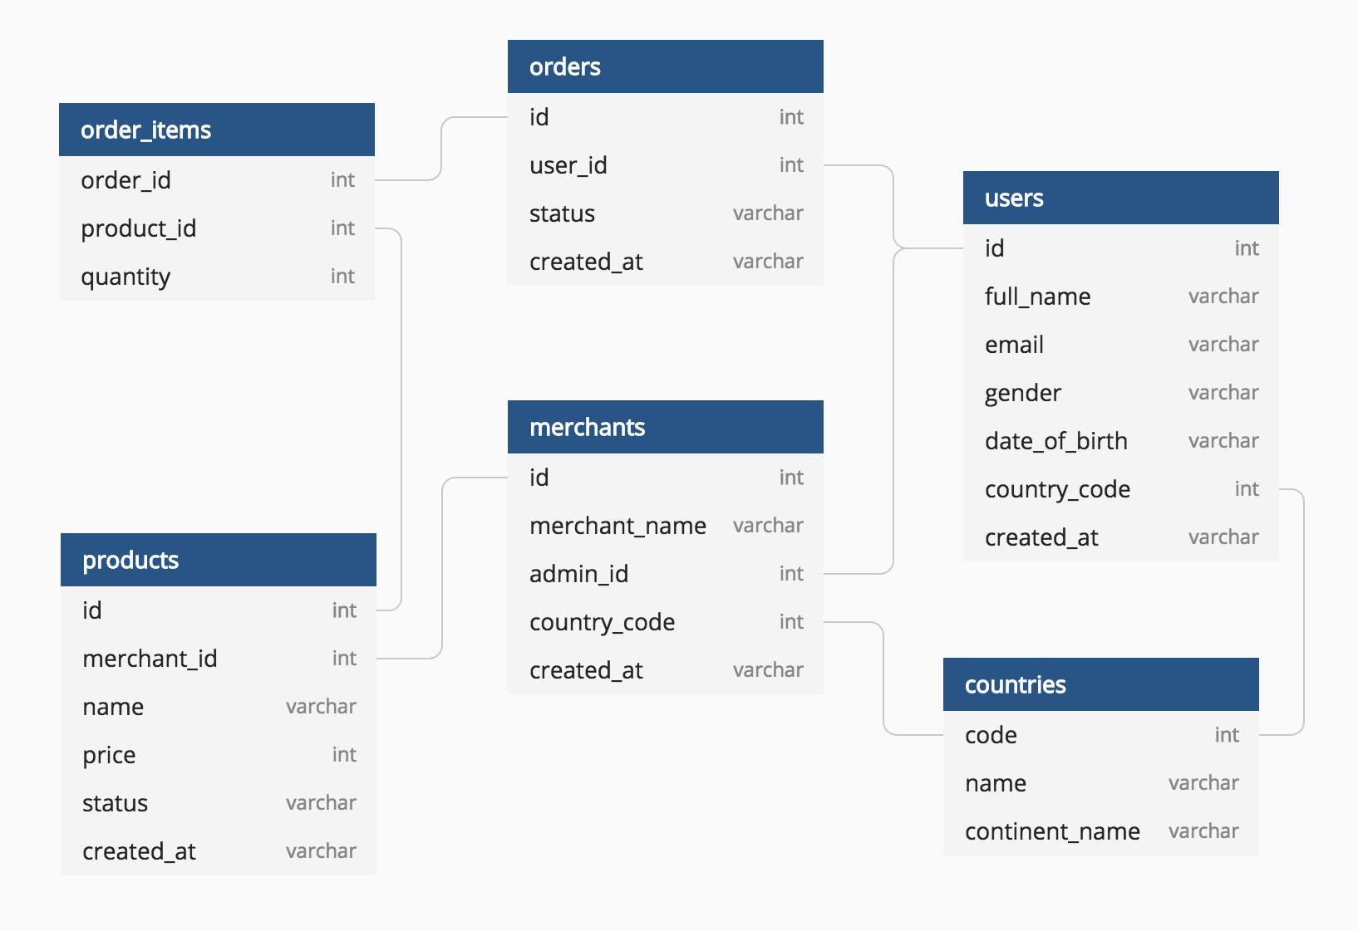
Schema Diagram
A schema is the blueprint of a database — it defines how data is organized.
Example

Slide 19











•
•
•
•
•
•
•
•
•
•
•

Slide 20

Data type of a column defines what value the column can store in table
Defined while creating tables in database
Data types mainly classified into three categories + most used
oString: char, varchar, etc
oNumeric: int, float, bool, etc
oDate and time: date, datetime, etc

Slide 21
int: used for the integer value
float: used to specify a decimal point number
bool: used to specify Boolean values true and false
char: fixed length string that can contain numbers, letters, and special characters
varchar: variable length string that can contain numbers, letters, and special characters
date: date format YYYY-MM-DD
datetime: date & time combination, format is YYYY-MM-DD hh:mm:ss

Slide 22



A Primary key is a unique column we set in a table to easily identify and locate data in queries
A table can have only one primary key, which should be unique and NOT NULL
A Foreign key is a column used to link two or more tables together
A table can have any number of foreign keys, can contain duplicate and NULL values

Slide 23

Constraints are used to specify rules for data in a table
This ensures the accuracy and reliability of the data in the table
Constraints can be specified when the table is created with the CREATE TABLE statement, or
after the table is created with the ALTER TABLE statement
Syntax
CREATE TABLE table_name ( column1 datatype constraint, column2 datatype constraint, column3 datatype constraint,
....
);

Slide 24
NOT NULL - Ensures that a column cannot have a NULL value
UNIQUE - Ensures that all values in a column are different
PRIMARY KEY - A combination of a NOT NULL and UNIQUE
FOREIGN KEY - Prevents actions that would destroy links between tables (used to link multiple tables together)
CHECK - Ensures that the values in a column satisfies a specific condition
DEFAULT - Sets a default value for a column if no value is specified
CREATE INDEX - Used to create and retrieve data from the database very quickly

Slide 25

Install SQL Server
(Postgre SQL)
Better to follow latest installation guide
Postgre Sql installer
Mysql installer
Microsoft Sql Sever installer

Slide 26
Creating Database & Tables
CRUD
Crud Operations : Download

Slide 27
Create DataBase
The create database statement helps us to create database
Syntax: CREATE DATABASE databasename;
Example: CREATE DATABASE student;
Delete Database
To delete a database we use DROP DATABASE statement and it will remove everything in database
Syntax: DROP DATABASE databasename;
Example: DROP DATABASE student;
Note: Make sure before drop the database backup everything and make sure you disconnect from the database

Slide 28

The CREATE TABLE statement is used to create a new table in a database
Syntax
CREATE TABLE table_name
(
column_name1 datatype constraint, column_name2 datatype constraint, column_name3 datatype constraint,
);
Example
CREATE TABLE customer
(
CustID int8 PRIMARY KEY,
CustName varchar(50) NOT NULL, Age int NOT NULL,
City char(50),
Salary numeric
);

Slide 29
Insert, Update, Delete Values in Table
+
Alter, Drop & Truncate Table

Slide 30

The INSERT INTO statement is used to insert new records in a table
Syntax
INSERT INTO TABLE_NAME
(column1, column2, column3,...columnN) VALUES
(value1, value2, value3,...valueN);
Example
INSERT INTO customer
(CustID, CustName, Age, City, Salary)
VALUES
(1, ‘Sam’, 26, ‘Delhi’, 9000),
(2, ‘Ram’, 19, ‘Bangalore’, 11000),
(3, ‘Pam’, 31, ‘Mumbai’, 6000),
(4, ‘Jam’, 42, ‘Pune’, 10000);
Other ways to insert data
INSERT INTO customer(CustID, CustName, Age, City, Salary)
values(5, ‘Ramya’, 19, ‘Bangalore’, 14000),
INSERT INTO customer values(6,'teja',24,’Kochi’,15000);

Slide 31

The UPDATE command is used to update existing rows in a table
Syntax
UPDATE TABLE_NAME
SET “Column_name1” = ‘value1’, “Column_name2” = ‘value2’ WHERE “ID” = ‘value’
Example
UPDATE customer
SET CustName = 'Xam’, Age= 32
WHERE CustID = 4;

Slide 32

The ALTER TABLE statement is used to add, delete, or modify columns in an existing table
ALTER TABLE – Modify COLUMN Data Type
Syntax
ALTER TABLE table_name
ALTER COLUMN column_name
TYPE newdatatype; -- postgresql
Example: change Salary from NUMERIC to INT
ALTER TABLE customer
ALTER COLUMN Salary TYPE INT;
ALTER TABLE customer
MODIFY Salary INT; -- For mysql
ALTER TABLE - ADD Column
Syntax
ALTER TABLE table_name
ADD COLUMN column_name ;
Example: add email column to customer table
ALTER TABLE customer
ADD Email VARCHAR(100);

Slide 33
ALTER TABLE - RENAME COLUMN
Syntax
ALTER TABLE table_name
RENAME COLUMN column_name TO new_Column_name;
Example: rename CustName to CustomerName:
ALTER TABLE customer
RENAME COLUMN CustName TO CustomerName;
ALTER TABLE - DROP COLUMN
Syntax
ALTER TABLE table_name
DROP COLUMN column_name;
Example: remove the City column:
ALTER TABLE customer
DROP COLUMN City;

Slide 34

The DELETE statement is used to delete existing records in a table
Syntax
DELETE
FROM table_name
WHERE condition;
Example
DELETE
FROM customer
WHERE CustID = 3;

Slide 35

The DROP TABLE command deletes a table in the database
Syntax
DROP TABLE table_name;
Example DROP TABLE customer
The TRUNCATE TABLE command deletes the data inside a table, but not the table itself
Syntax
TRUNCATE TABLE table_name;
Example
TRUNCATE TABLE customer

Slide 36
Filtering & Sorting

Slide 37
Creating a Products table for practice
-- Create the Products table
CREATE TABLE Products (
ProductID INT PRIMARY KEY,
ProductName VARCHAR(50) NOT NULL,
Category VARCHAR(30),
Price INT,
Stock INT
);
-- Insert data
INSERT INTO Products (ProductID, ProductName, Category, Price, Stock)
VALUES
(1, 'Laptop', 'Electronics', 55000, 25),
(2, 'Headphones', 'Electronics', 1500, 100),
(3, 'Coffee Mug', 'Kitchen', 300, 200),
(4, 'Office Chair', 'Furniture', 7000, 15),
(5, 'Smartphone', 'Electronics', 25000, 40),
(6, 'Blender', 'Kitchen', 1800, 60),
(7, 'Desk Lamp', 'Furniture', 1200, 80),
(8, 'Monitor', 'Electronics', 12000, 30);

Slide 38

The SELECT statement is used to select data from a database.
Syntax
SELECT column_name FROM table_name;
To select all the fields available in the table
Syntax
SELECT * FROM table_name;
To select distinct/unique fields available in the table
Syntax
SELECT DISTINCT Column_name FROM table_name;

Slide 39

The SQL reserved words and characters are called operators, which are used with a WHERE clause in a SQL query
Most used operators:
Arithmetic operators : arithmetic operations on numeric values
Example: Addition (+), Subtraction (-), Multiplication (*), Division (/), Modulus (%)
Comparison operators: compare two different data of SQL table
Example: Equal (=), Not Equal (!=), Greater Than (>), Greater Than Equals to (>=)
Logical operators: perform the Boolean operations
Example: AND, OR, NOT, ANY
Bitwise operators: perform the bit operations on the Integer values
Example: Bitwise AND (&), Bitwise OR(|)

Slide 40
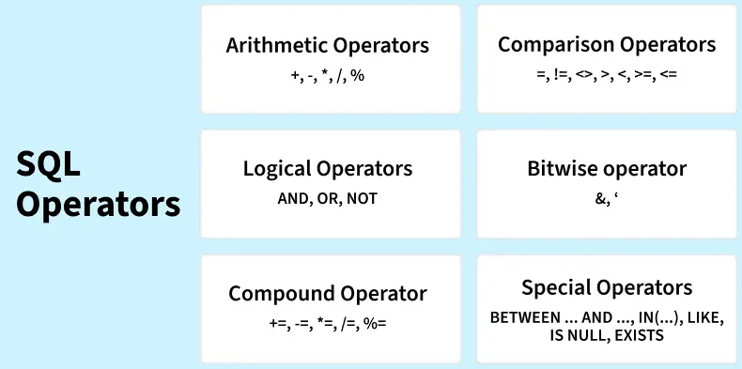
|, ~,^

Slide 41

The WHERE clause is used to filter records.
SQL clauses are used to specify conditions and manipulate data in a database.
It is used to extract only those records that fulfill a specified condition
Syntax
SELECT column_name FROM table_name
WHERE conditions;
Example
select * from products
where category='Electronics';

Slide 42

The LIMIT clause is used to set an upper limit on the number of rows returned by SQL.
Example: below code will return 5 rows of data SELECT column_name FROM table_name LIMIT 5;
OFFSET Clause
The OFFSET clause in SQL is used to skip a specific number of rows before starting to return results. It’s often used with LIMIT to implement pagination — like showing page 2 of search results.
Syntax:
SELECT columns
FROM table
ORDER BY column
OFFSET n ROWS
LIMIT m;

Slide 43

The ORDER BY is used to sort the result-set in ascending (ASC) or descending
order (DESC).
Example: below code will sort the output data by column name in ascending order
SELECT column_name FROM table_name
ORDER BY column_name e ASC;
Example: Sort products by price (lowest to highest) and Skip the first 2 cheapest products to Show the next 3
SELECT ProductName, Price
FROM Products
ORDER BY Price ASC
OFFSET 2 -- skips first 2 products
LIMIT 3; -- gives next 3 products

Slide 44
IMPORT CSV FILE
Customer Csv file : Download
Payment CSV file : Download

Slide 45
Import CSV into SQL
To import a CSV file into SQL we can use different methods depending on your setup. Here's a universal workflow using SQL and command-line tools, especially useful for PostgreSQL and MySQL.
Step1: Prepare Your CSV File
Make sure your file is clean:
Headers match column names
No missing quotes or delimiters
Example: payment.csv (make sure you download it )
CREATE TABLE Payments (
customer_id INT,
amount INT,
mode VARCHAR(30),
payment_date DATE
);
Step2: Create a Table with columns names with datatypes matching the csv header files
Example: In payments.csv we have 4 columns
customer_id, amount, mode, payment_date

Slide 46
Mysql
Postgresql
LOAD DATA LOCAL INFILE '/path/to/payments.csv'
INTO TABLE Payments
FIELDS TERMINATED BY ','
ENCLOSED BY ‘ “ '
LINES TERMINATED BY '\n'
IGNORE 1 ROWS;
Make sure the CSV is in the correct path.
Syntax:
COPY Table_name
FROM ‘location of csv’
DELIMITER ',’
CSV HEADER;
Error Code: 1290. The MySQL server is running with the --secure-file-priv option so it cannot execute this statement follow these steps
Example:
COPY Payments
FROM 'E:\payments.csv’ DELIMITER ',’
CSV HEADER;
Open your terminal(cmd or powershell) run one by one these commands and make sure enter your password after first command
mysql --local-infile=1 -u root –p
SET GLOBAL local_infile = 1;
SHOW VARIABLES LIKE 'local_infile’;
Then Exit and Restart the sql server
Using psql terminal : \COPY Payments FROM ‘E:\payments.csv' DELIMITER ',' CSV HEADER;

Slide 47
FUNCTIONS

Slide 48

Functions in SQL are the database objects that contains a set of SQL statements to perform a specific task. A function accepts input parameters, perform actions, and then return the result.
Types of Function:
System Defined Function : these are built-in functions
Example: rand(), round(), upper(), lower(), count(), sum(), avg(), max(), etc
2. User-Defined Function : Once you define a function, you can call it in the same way as the built-in functions
Scalar functions → operate on single values (numeric (abs), string, date).
Aggregate functions → operate on sets of rows.

Slide 49
Aggregate function performs a calculation on multiple values (rows) and returns a single value.
And Aggregate functiona are often used with GROUP BY & SELECT statement
COUNT() returns number of values
SUM() returns sum of all values
AVG() returns average value
MAX() returns maximum value
MIN() returns minimum value
ROUND() Rounds a number to a specified number of decimal places

Slide 50
String functions are used to perform an operation on input string and return an output string
UPPER() converts the value of a field to uppercase
LOWER() converts the value of a field to lowercase
LENGTH() returns the length of the value in a text field
SUBSTRING() extracts a substring from a string
NOW() returns the current system date and time
FORMAT() used to set the format of a field
CONCAT() adds two or more strings together
REPLACE() Replaces all occurrences of a substring within a string, with a new substring
TRIM() removes leading and trailing spaces (or other specified characters) from a string

Slide 51
Payments_fun table
Solve these Using Payments_fun table
CREATE TABLE Payments_fun (payment_id INT PRIMARY KEY, customer_name VARCHAR(50),
amount DECIMAL(10,2),
mode VARCHAR(30),
payment_date DATE);
INSERT INTO Payments_fun (payment_id, customer_name, amount, mode, payment_date) VALUES(1, 'Arjun', 60, 'Cash', '2020-09-24’),
(2, 'Meera', 30, 'Credit Card', '2020-04-27’),
(3, 'Ravi', 90, 'Credit Card', '2020-07-07’),
(4, 'Sneha', 50, 'Debit Card', '2020-02-12’),
(5, 'Kiran', 40, 'Mobile Payment', '2020-11-20’),
(6, 'Priya', 40, 'Debit Card', '2021-06-28’),
(7, 'Rahul', 10, 'Cash', '2021-08-25’),
(8, 'Anita', 30, 'Mobile Payment', '2021-06-17’),
(9, 'Vikram', 80, 'Cash', '2021-08-25’),
(10, 'Divya', 50, 'Mobile Payment', '2021-11-03’),
(11, 'Suresh', 70, 'Cash', '2022-11-01’),
(12, 'Neha', 60, 'Netbanking', '2022-09-11’),
(13, 'Ajay', 30, 'Netbanking', '2022-12-10’),
(14, 'Varun', 50, 'Credit Card', '2022-05-14’),
(15, 'Pooja', 30, 'Credit Card', '2022-09-25');
1. Find the absolute difference between the highest and lowest payment amounts.
2. Round the average payment amount to 2 decimal places
3. Show all customer names in uppercase.
4. Extract the first 3 letters of each payment mode.
5. Find all payments made in 2021.
6. Calculate the number of days between the earliest and latest payment
7. Count how many payments were made by Credit Card.
8. Find the total amount collected per payment mode

Slide 52
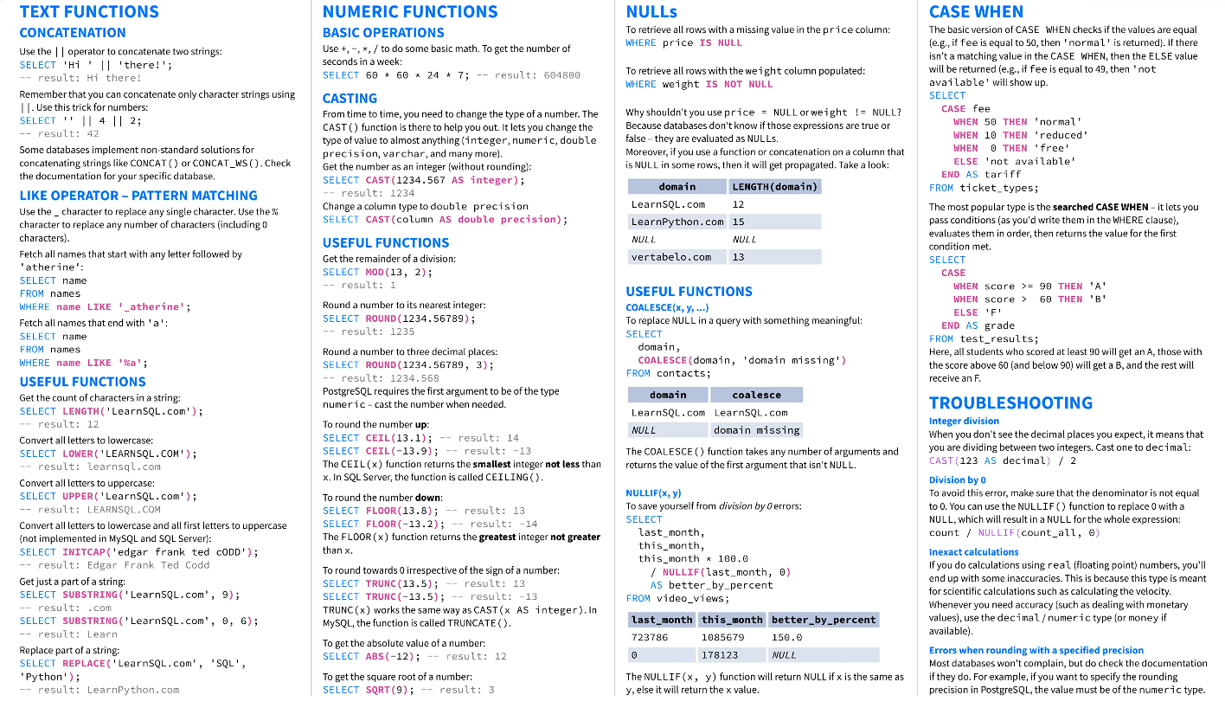
Functions Cheat Sheet

Slide 53
GROUP BY & HAVING CLAUSE

Slide 54

The GROUP BY statement group rows that have the same values into summary rows.
It is often used with aggregate functions (COUNT(), MAX(), MIN(), SUM(), AVG()) to group the result-set by one or more columns
Syntax
SELECT column_name(s)
FROM table_name
GROUP BY column_name(s);
Example
SELECT mode, SUM(amount) AS total
FROM payment_fun
GROUP BY mode
Why do we get an error when selecting a column not present in GROUP BY?
Because SQL requires that all selected columns must either be aggregated or included in the GROUP BY clause to avoid ambiguous results.

Slide 55

The HAVING clause is used to apply a filter on the result of GROUP BY based on the
specified condition.
The WHERE clause places conditions on the selected columns, whereas the HAVING
clause places conditions on groups created by the GROUP BY clause
Syntax
SELECT column_name(s) FROM table_name WHERE condition(s)
GROUP BY column_name(s)
HAVING condition(s)
Example
SELECT mode, COUNT(amount) AS total
FROM payment_fun
GROUP BY mode
HAVING COUNT(amount) >= 3
ORDER BY total DESC

Slide 56
SQL Query Mnemonic
Memorable word from the first letters of each SQL Clause
SQL Query
Select
From
Join
On
Where
Group By
Having
Order By
Limit
‘SFJOWGHOL’
Memorable Word
‘Silly Frogs Jump On Wet Grass, Hopping Over Logs’

Slide 57

Order of execution in SQL:
SELECT, FROM, WHERE, GROUP BY, HAVING, ORDER BY, LIMIT
?

Slide 58
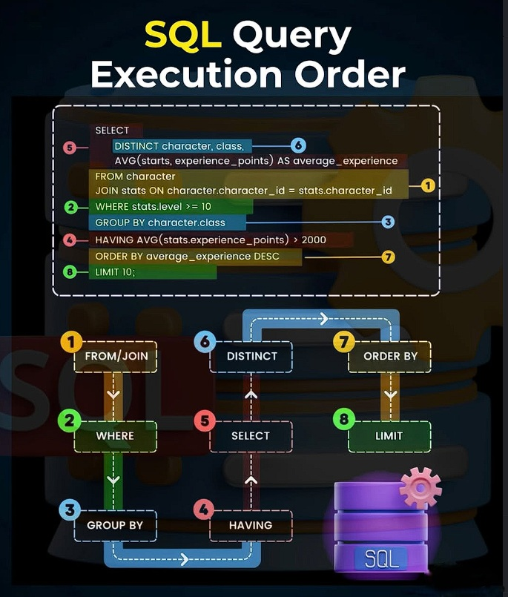
SQL doesn’t execute queries top-to-bottom as written.
Why It Works This Way
FROM: SQL needs to know where to pull data from first.
WHERE: Filters rows before any grouping happens.
GROUP BY: Aggregates rows into groups.
HAVING: Filters those groups (like WHERE for groups).
SELECT: Only now does SQL know what columns to return.
ORDER BY: Sorts the final result.
LIMIT: Trims the result set.
Pro Tips
HAVING always comes after GROUP BY — it filters groups, not rows.
SELECT can’t reference aliases until after aggregation.
ORDER BY can use aliases from SELECT.

Slide 59
TIMESTAMPS & EXTRACT

Slide 60

The TIMESTAMP data type is used for values that contain both date and time parts
TIME contains only time, format HH:MI:SS
DATE contains on date, format YYYY-MM-DD
YEAR contains on year, format YYYY or YY
TIMESTAMP contains date and time, format YYYY-MM-DD HH:MI:SS
TIMESTAMPTZ contains date, time and time zone

Slide 61
CAST() : Converts a timestamp into a pure date (drops time).
SELECT CAST(transaction_ts AS DATE) -- 2024-10-07
FROM transactions_d;
::DATE : Postgresql shot hand
SELECT transaction_ts::Date as onlydate -- 2024-10-07
from transactions_d;
TO_CHAR() : Converts a date/time into a formatted string. Perfect for reports and dashboards.
Syntax: TO_CHAR(timestamp column, 'format')
TO_CHAR(transaction_ts, 'YYYY-MM-DD’) -- "2024-10-07"
TO_CHAR(transaction_ts, 'Dy') -- "Mon"
TO_CHAR(transaction_ts, 'HH24:MI') -- "14:05"
DATE_TRUNC() : Rounds a timestamp down to a specified unit.
SELECT DATE_TRUNC('month', transaction_ts) as month, -- 2024-10-01 00:00:00
DATE_TRUNC('day', transaction_ts)as day, -- 2024-10-07 00:00:00
DATE_TRUNC('hour', transaction_ts) as hour -- 2024-10-07 14:00:00
from transactions_d;

Slide 62
Below are the TIMESTAMP functions and operators in SQL:
SHOW TIMEZONE
SELECT NOW()
SELECT TIMEOFDAY()
SELECT CURRENT_TIME
SELECT CURRENT_DATE

Slide 63
TIMEZONE : Stores timestamp with time zone offset.
SELECT transaction_ts AT TIME ZONE 'Asia/Kolkata' AS ist_time,
transaction_ts AT TIME ZONE 'UTC' AS utc_time
FROM Transactions_d;
NOW() : Returns the current timestamp (date + time).
SELECT NOW() AS current_timestamp; -- Output: 2026-01-01 17:18:00
TIMEOFDAY() : Returns a text string with current time info.
SELECT TIMEOFDAY(); -- Output: 'Thu Jan 01 17:18:00 IST 2026’
CURRENT_DATE / CURRENT_TIME : Returns just the current date or time.
SELECT CURRENT_DATE AS today,
CURRENT_TIME AS current_time; -- Output: 2026-01-01 | 17:18:00
TIMEOFDAY() : Returns a text string with current time info.
SELECT TIMEOFDAY(); -- Output: 'Thu Jan 01 17:18:00 IST 2026'

Slide 64

The EXTRACT() function extracts a part from a given date value.
Syntax: SELECT EXTRACT(MONTH FROM date_field) FROM Table
YEAR
QUARTER
MONTH
WEEK
DAY
HOUR
MINUTE
DOW – day of week
DOY – day of year
SELECT transaction_id,
EXTRACT(YEAR FROM transaction_ts) AS year,
EXTRACT(MONTH FROM transaction_ts) AS month,
EXTRACT(QUARTER FROM transaction_ts) AS quater,
EXTRACT(WEEK FROM transaction_ts) AS week,
EXTRACT(DAY FROM transaction_ts) AS day,
EXTRACT(HOUR FROM transaction_ts) AS hour,
EXTRACT(MINUTE FROM transaction_ts) AS minute,
EXTRACT(DOW FROM transaction_ts) AS dow,
EXTRACT(DOY FROM transaction_ts) AS doy
FROM Transactions_d;

Slide 65
JOINS

Slide 66

TOPICS IN JOIN
WHAT IS JOIN?
USE OF JOIN
JOIN TYPES
WHICH JOIN TO USE
JOIN SYNTAX
EXAMPLES IN SQL

Slide 67


JOIN means to combine something.
A JOIN clause is used to combine data from two or more tables, based on a related column between them
Let’s understand the joins through an example:

Slide 68
What Is Cardinality?
Cardinality describes the number of relationships between rows in one table and rows in another table.
It answers the question:
“How many rows in Table A relate to how many rows in Table B?”
Common Types of Cardinality
Type | Symbol | Meaning
One-to-One | 1:1 | Each row in Table A matches one row in Table B
One-to-Many | 1:N | Each row in Table A matches many rows in Table B
Many-to-One | N:1 | Many rows in Table A match one row in Table B
Many-to-Many | N:N | Many rows in Table A match many rows in Table B (requires bridge table)

Slide 69

Question: How much amount was paid by customer ‘Madan’, what was
mode and payment date?
payment
customer_id
customer customer_id first_name
last_name address_id
amount
mode Payment_date
country
city_id city country
address
address_id address city_id postal_code phone
Database

Slide 70
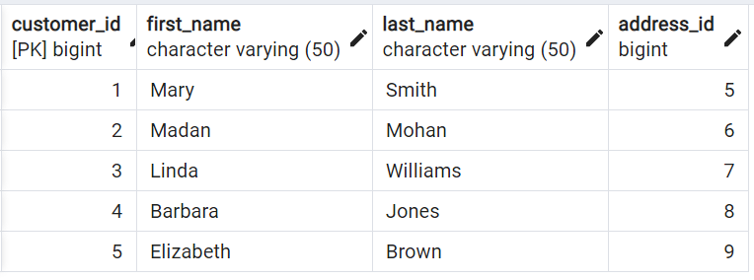
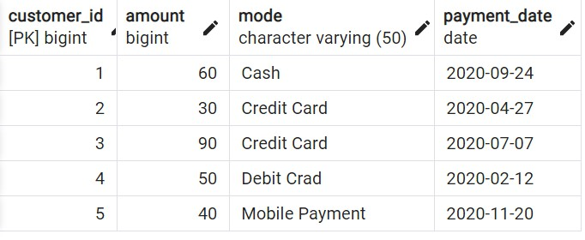
Question: How much amount was paid by customer ‘Madan’, what was mode and payment date?
Answer: Amount = 30, Mode = Credit Card, Date = 2020-04-27

Slide 71

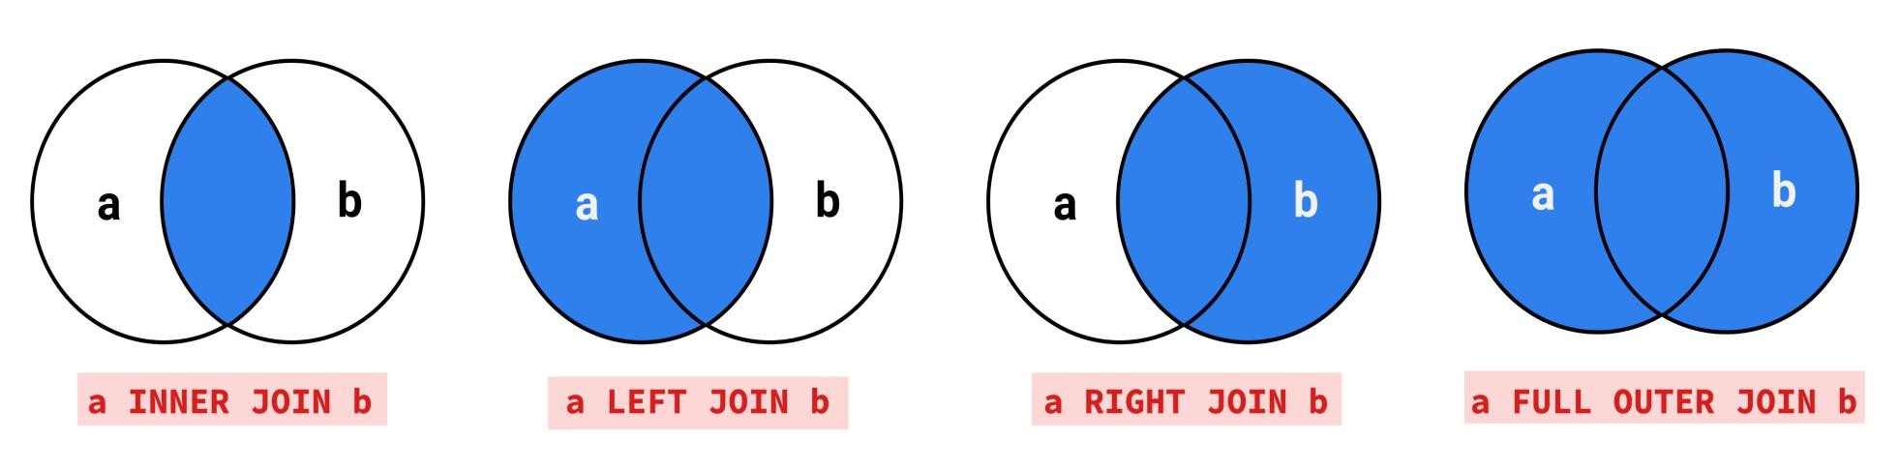
INNER JOIN
OUTER JOIN
1. LEFT OUTER JOIN
2. RIGHT OUTER JOIN
3. FULL OUTER JOIN

Slide 72


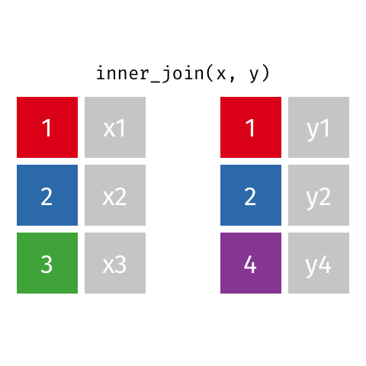
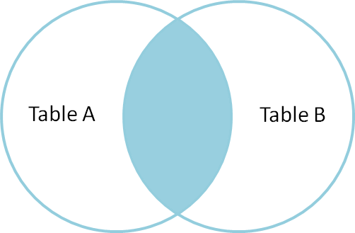
Returns records that have matching values in both tables

Slide 73
Syntax
SELECT column_name(s) FROM TableA
INNER JOIN TableB
ON TableA.col_name = TableB.col_name
Example
SELECT *
FROM customer AS c INNER JOIN payment AS p
ON c.customer_id = p.customer_id

Slide 74



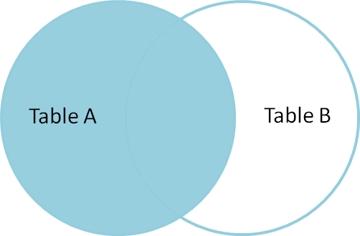
Returns all records from the left table, and the matched records from the right table

Slide 75
Syntax
SELECT column_name(s) FROM TableA
LEFT JOIN TableB
ON TableA.col_name = TableB.col_name
Example
SELECT *
FROM customer AS c LEFT JOIN payment AS p
ON c.customer_id = p.customer_id

Slide 76



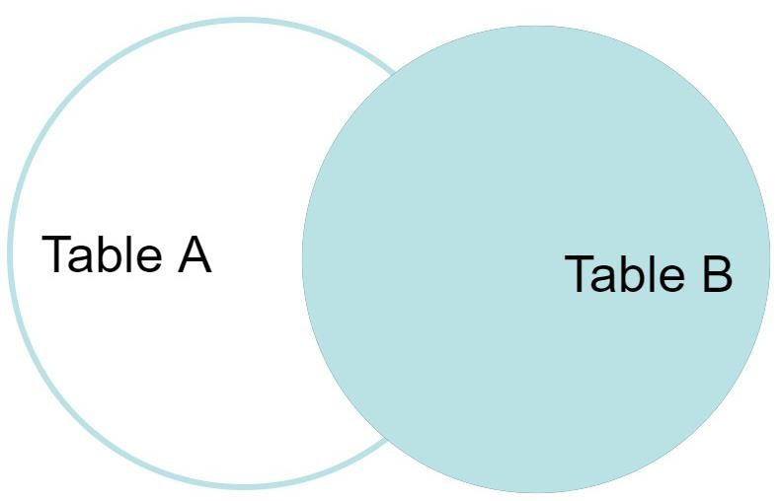
Returns all records from the right table, and the matched records from the left table

Slide 77
Syntax
SELECT column_name(s) FROM TableA
RIGHT JOIN TableB
ON TableA.col_name = TableB.col_name
Example
SELECT *
FROM customer AS c RIGHT JOIN payment AS p
ON c.customer_id = p.customer_id

Slide 78


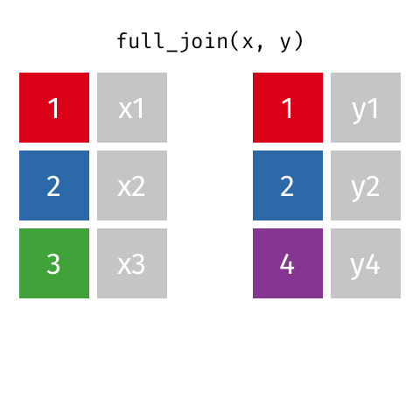
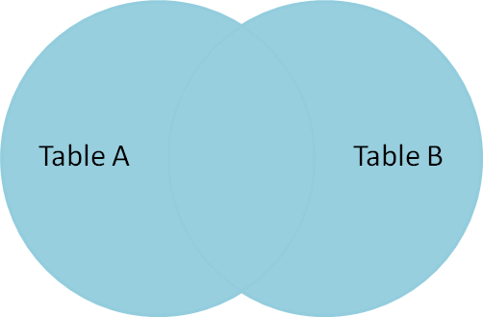
Returns all records when there is a match in either left or right table

Slide 79
Syntax
SELECT column_name(s) FROM TableA
FULL OUTER JOIN TableB
ON TableA.col_name = TableB.col_name
Example
SELECT *
FROM customer AS c
FULL OUTER JOIN payment AS p ON c.customer_id = p.customer_id

Slide 80

INNER JOIN: Returns records that have matching values in both tables
LEFT JOIN: Returns all records from the left table, and the matched records from the right table
RIGHT JOIN: Returns all records from the right table, and the matched records from the left table
FULL JOIN: Returns all records when there is a match in either left or right table

Slide 81





Slide 82
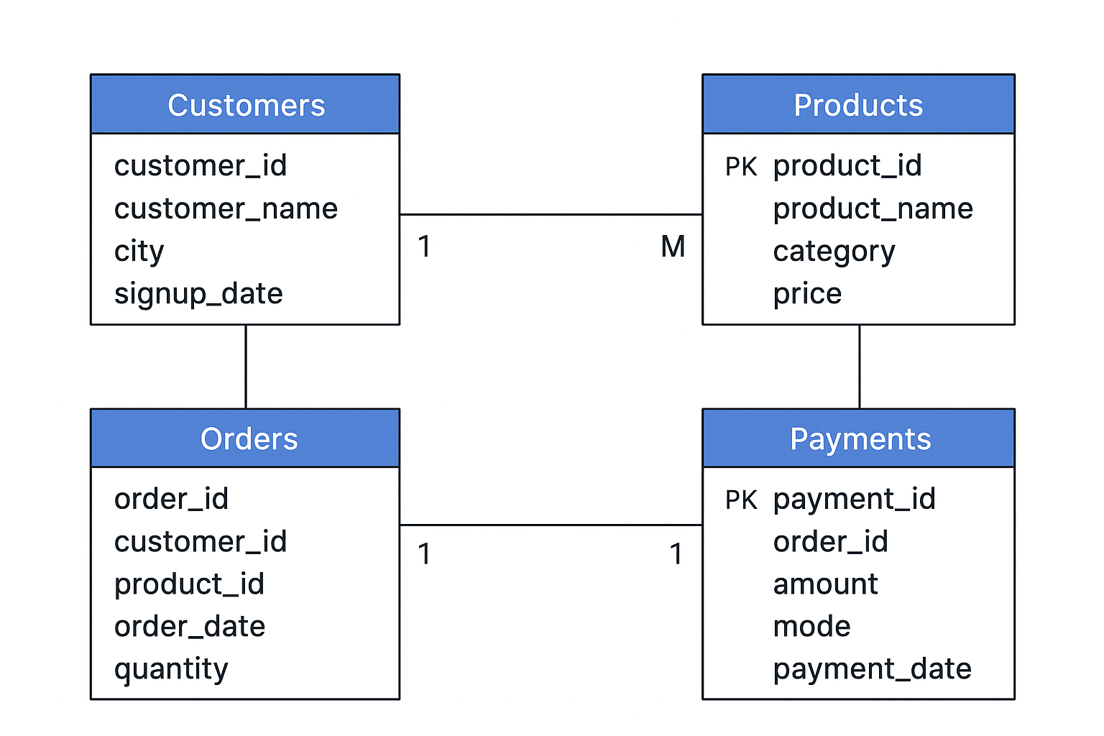
Database

Slide 83
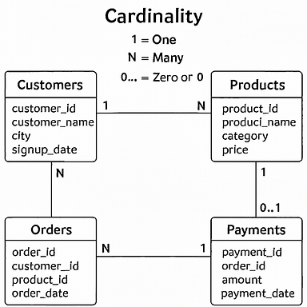
Relationship | Cardinality | Meaning
Customers → Orders | 1:N | One customer can place many orders
Orders → Products | N:1 | Many orders can contain the same product (each order has one product)
Orders → Payments | 1:1 | Each order has one payment (and each payment belongs to one order)

Slide 84
SELF JOIN

Slide 85

A self join is a regular join in which a table is joined to itself
SELF Joins are powerful for comparing values in a column of rows with the same table
Syntax
SELECT column_name(s) FROM Table AS T1
JOIN Table AS T2
ON T1.col_name = T2.col_name

Slide 86

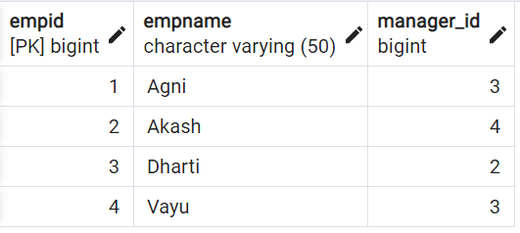
Table: emp
Find the name of respective managers for each of the employees?

Slide 87
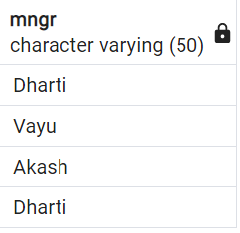
SELECT T2.empname, T1.empname
FROM emp AS T1 JOIN emp AS T2
ON T1.empid = T2.manager_id

Slide 88

The SQL UNION clause/operator is used to combine/concatenate the results
of two or more SELECT statements without returning any duplicate rows and keeps unique records
To use this UNION clause, each SELECT statement must have
The same number of columns selected and expressions
The same data type and
Have them in the same order
Syntax
SELECT column_name(s) FROM TableA UNION
SELECT column_name(s) FROM TableB
Example
SELECT cust_name, cust_amount from custA
UNION
SELECT cust_name, cust_amount from custB

Slide 89

In UNION ALL everything is same as UNION, it combines/concatenate two or more table but keeps all records, including duplicates
Syntax
SELECT column_name(s) FROM TableA UNION ALL
SELECT column_name(s) FROM TableB
Example
SELECT cust_name, cust_amount from custA
UNION ALL
SELECT cust_name, cust_amount from custB

Slide 90

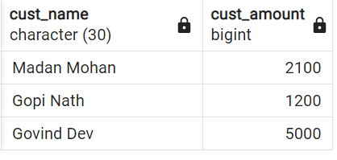
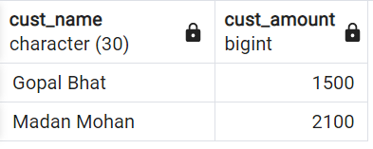
Table: custB
Table: custA

Slide 91
SUB QUERY

Slide 92

A Subquery or Inner query or a Nested query allows us to create complex query on the output of another query
Sub query syntax involves two SELECT statements
Syntax
SELECT column_name(s) FROM table_name
WHERE column_name operator
( SELECT column_name FROM table_name WHERE ... );

Slide 93

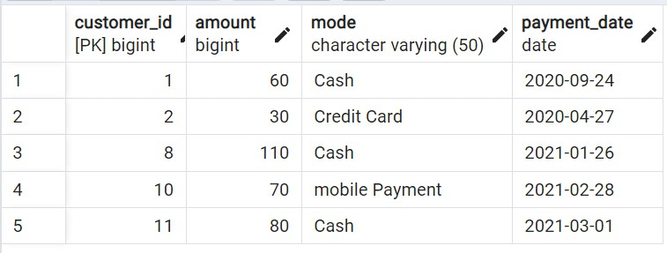
Question: Find the details of customers, whose payment amount is more than the average of total amount paid by all customers
Divide above question into two parts:
Find the average amount
Filter the customers whose amount > average amount

Slide 94
WINDOWS FUNCTION

Slide 95

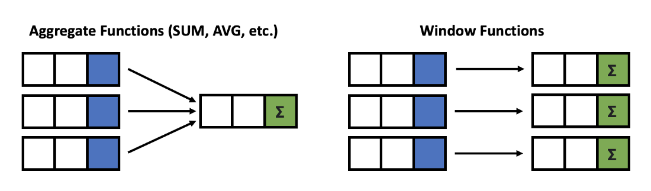
Window functions applies aggregate, ranking and analytic functions over a particular window (set of rows).
And OVER clause is used with window functions to define that window.
Give output one row per aggregation
The rows maintain their separate identities

Slide 96
SELECT column_name(s),
fun( )
OVER
( [ <PARTITION BY Clause> ] [ <ORDER BY Clause> ]
[ <ROW or RANGE Clause> ] )
FROM table_name
Select a function
Aggregate functions
Ranking functions
Analytic functions
Define a Window
PARTITION BY
ORDER BY
ROWS

Slide 97
Let’s look at some definitions:
Window function applies aggregate, ranking and analytic functions over a particular window; for example, sum, avg, or row_number
Expression is the name of the column that we want the window function operated on. This may not be necessary depending on what window function is used
OVER is just to signify that this is a window function
PARTITION BY divides the rows into partitions so we can specify which rows to use to compute the window function
ORDER BY is used so that we can order the rows within each partition. This is optional and does not have to be specified
ROWS can be used if we want to further limit the rows within our partition. This is optional and usually not used

Slide 98
There is no official division of the SQL window functions into categories but high level we can divide into three types
Window Functions
Aggregate
SUM
AVG
COUNT
MIN
MAX
Ranking
ROW_NUMBER
RANK
DENSE_RANK
PERCENT_RANK
Value/Analytic
LEAD
LAG
FIRST_VALUE
LAST_VALUE

Slide 99
SELECT new_id, new_cat,
SUM(new_id) OVER( PARTITION BY new_cat ORDER BY new_id ) AS "Total",
AVG(new_id) OVER( PARTITION BY new_cat ORDER BY new_id ) AS "Average",
COUNT(new_id) OVER( PARTITION BY new_cat ORDER BY new_id ) AS "Count", MIN(new_id) OVER( PARTITION BY new_cat ORDER BY new_id ) AS "Min", MAX(new_id) OVER( PARTITION BY new_cat ORDER BY new_id ) AS "Max" FROM test_data
AGGREGATE FUNCTION
Example
new_id | new_cat | Total | Average | Count | Min | Max
100 | Agni | 300 | 150 | 2 | 100 | 200
200 | Agni | 300 | 150 | 2 | 100 | 200
500 | Dharti | 1200 | 600 | 2 | 500 | 700
700 | Dharti | 1200 | 600 | 2 | 500 | 700
200 | Vayu | 1000 | 333.33333 | 3 | 200 | 500
300 | Vayu | 1000 | 333.33333 | 3 | 200 | 500
500 | Vayu | 1000 | 333.33333 | 3 | 200 | 500

Slide 100
SELECT new_id, new_cat,
SUM(new_id) OVER( ORDER BY new_id ROWS BETWEEN UNBOUNDED PRECEDING AND UNBOUNDED FOLLOWING) AS "Total",
AVG(new_id) OVER( ORDER BY new_id ROWS BETWEEN UNBOUNDED PRECEDING AND UNBOUNDED FOLLOWING) AS "Average", COUNT(new_id) OVER( ORDER BY new_id ROWS BETWEEN UNBOUNDED PRECEDING AND UNBOUNDED FOLLOWING) AS "Count", MIN(new_id) OVER( ORDER BY new_id ROWS BETWEEN UNBOUNDED PRECEDING AND UNBOUNDED FOLLOWING) AS "Min", MAX(new_id) OVER( ORDER BY new_id ROWS BETWEEN UNBOUNDED PRECEDING AND UNBOUNDED FOLLOWING) AS "Max"
FROM test_data
new_id | new_cat | Total | Average | Count | Min | Max
100 | Agni | 2500 | 357.14286 | 7 | 100 | 700
200 | Agni | 2500 | 357.14286 | 7 | 100 | 700
200 | Vayu | 2500 | 357.14286 | 7 | 100 | 700
300 | Vayu | 2500 | 357.14286 | 7 | 100 | 700
500 | Vayu | 2500 | 357.14286 | 7 | 100 | 700
500 | Dharti | 2500 | 357.14286 | 7 | 100 | 700
700 | Dharti | 2500 | 357.14286 | 7 | 100 | 700
AGGREGATE FUNCTION
Example
NOTE: Above we have used: “ROWS BETWEEN UNBOUNDED PRECEDING AND UNBOUNDED FOLLOWING”
which will give a SINGLE output based on all INPUT Va_{S}lu_{QL}e_{B}s_{y}/P_{R}A_{ish}R_{a}T_{b}I_{h}T_{M}IO_{is}N_{hra}(if used)

Slide 101
SELECT new_id,
ROW_NUMBER() OVER(ORDER BY new_id) AS "ROW_NUMBER",
RANKING FUNCTION
Example
RANK() OVER(ORDER BY new_id) AS "RANK",
DENSE_RANK() OVER(ORDER BY new_id) AS "DENSE_RANK", PERCENT_RANK() OVER(ORDER BY new_id) AS "PERCENT_RANK"
FROM test_data
new_id | ROW_NUMBER | RANK | DENSE_RANK | PERCENT_RANK
100 | 1 | 1 | 1 | 0
200 | 2 | 2 | 2 | 0.166
200 | 3 | 2 | 2 | 0.166
300 | 4 | 4 | 3 | 0.5
500 | 5 | 5 | 4 | 0.666
500 | 6 | 5 | 4 | 0.666
700 | 7 | 7 | 5 | 1

Slide 102
SELECT new_id,
FIRST_VALUE(new_id) OVER( ORDER BY new_id) AS "FIRST_VALUE",
ANALYTIC FUNCTION
Example
LAST_VALUE(new_id) OVER( ORDER BY new_id) AS "LAST_VALUE",
LEAD(new_id) OVER( ORDER BY new_id) AS "LEAD", LAG(new_id) OVER( ORDER BY new_id) AS "LAG" FROM test_data
new_id | FIRST_VALUE | LAST_VALUE | LEAD | LAG
100 | 100 | 100 | 200 | null
200 | 100 | 200 | 200 | 100
200 | 100 | 200 | 300 | 200
300 | 100 | 300 | 500 | 200
500 | 100 | 500 | 500 | 300
500 | 100 | 500 | 700 | 500
700 | 100 | 700 | null | 500
NOTE: If you just want the single last value from whole column, use: “ROWS BETWEEN UNBOUNDED PRECEDING AND UNBOUNDED FOLLOWING”

Slide 103
Offset the LEAD and LAG values by 2 in the output columns ?
INPUT
OUTPUT
new_id
100
200
200
300
500
500
700
new_id | LEAD | LAG
100 | 200 | NULL
200 | 300 | NULL
200 | 500 | 100
300 | 500 | 200
500 | 700 | 200
500 | NULL | 300
700 | NULL | 500

Slide 104
SELECT new_id,
LEAD(new_id, 2) OVER( ORDER BY new_id) AS "LEAD_by2",
ANALYTIC FUNCTION
Assignment
LAG(new_id, 2) OVER( ORDER BY new_id) AS "LAG_by2"
FROM test_data
new_id | LEAD_by2 | LAG_by2
100 | 200 | null
200 | 300 | null
200 | 500 | 100
300 | 500 | 200
500 | 700 | 200
500 | null | 300
700 | null | 500

Slide 105
CASE EXPRESSION

Slide 106

The CASE expression goes through conditions and returns a value when the first condition is met (like if-then-else statement). If no conditions are true, it returns the value in the ELSE clause.
If there is no ELSE part and no conditions are true, it returns NULL.
Also called CASE STATEMENT

Slide 107









Slide 108

General CASE Syntax
CASE
WHEN condition1 THEN result1 WHEN condition2 THEN result2 WHEN conditionN THEN resultN ELSE other_result
END;
Example:
SELECT customer_id, amount, CASE
WHEN amount > 100 THEN 'Expensive product' WHEN amount = 100 THEN 'Moderate product' ELSE 'Inexpensive product'
END AS ProductStatus FROM payment

Slide 109

CASE Expression Syntax
CASE Expression
WHEN value1 THEN result1 WHEN value2 THEN result2 WHEN valueN THEN resultN ELSE other_result
END;
Example:
SELECT customer_id,
CASE amount
WHEN 500 THEN 'Prime Customer' WHEN 100 THEN 'Plus Customer'
ELSE 'Regular Customer' END AS CustomerStatus FROM payment

Slide 110
COMMON TABLE EXPRESSION

Slide 111
A common table expression, or CTE, is a temporary named result set created from a simple SELECT statement that can be used in a subsequent SELECT statement
We can define CTEs by adding a WITH clause directly before SELECT, INSERT, UPDATE, DELETE, or MERGE
statement.
The WITH clause can include one or more CTEs separated by commas

Slide 112





👉
👉

Slide 113
Syntax
WITH my_cte AS (
SELECT a,b,c
FROM Table1 )
SELECT a,c
FROM my_cte
CTE query
Main query
The name of this CTE is my_cte, and the CTE query is SELECT a,b,c FROM Table1. The CTE starts with the WITH keyword, after which you specify the name of your CTE, then the content of the query in parentheses. The main query comes after the closing parenthesis and refers to the CTE. Here, the main query (also known as the outer query) is SELECT a,c FROM my_cte

Slide 114



1. Example EASY
WITH my_cte AS (
SELECT *, AVG(amount) OVER(ORDER BY
p.customer_id) AS "Average_Price",
COUNT(address_id) OVER(ORDER BY c.customer_id) AS "Count"
FROM payment as p
INNER JOIN customer AS c
ON p.customer_id = c.customer_id
)
SELECT first_name, last_name FROM my_cte
1. Example Multiple CTEs
WITH my_cp AS (
SELECT *, AVG(amount) OVER(ORDER BY p.customer_id) AS "Average_Price",
COUNT(address_id) OVER(ORDER BY c.customer_id) AS
"Count"
FROM payment as p INNER JOIN customer AS c
ON p.customer_id = c.customer_id
),
my_ca AS (
SELECT *
FROM customer as c INNER JOIN address AS a
ON a.address_id = c.address_id INNER JOIN country as cc
ON cc.city_id = a.city_id
)
SELECT cp.first_name, cp.last_name, ca.city, ca.country, cp.amount FROM my_ca as ca , my_cp as cp
2. Example Advance
WITH my_cte AS (
SELECT mode, MAX(amount) AS highest_price, SUM(amount) AS total_price
FROM payment GROUP BY mode
)
SELECT payment.*, my.highest_price, my.total_price
FROM payment JOIN my_cte my
ON payment.mode = my.mode ORDER BY payment.mode

